Slide 1
Udacity Connect Session
February 10, 2018
Thinking Like a Machine Learnist
Tools of the Trade

Slide 2
Welcome!

Slide 3
Morning Schedule
10:00 - 10:30 | Introductions
10:30 - 11:00 | Overview of Program
11:00 - 11:40 | Tool up!
11:40 - noon | What are we going to learn here -- the 30,000 ft perspective
© 2016 Udacity. All rights reserved.

Slide 4

Lutfur Khundkar
SESSION LEAD
Was born
Happy childhood
Came to US for college
Studied hard, played some
Taught Chemistry
Develop Software for Hospitals
Use ML/AI to improve healthcare access
© 2016 Udacity. All rights reserved.

Slide 5
Introductions
GETTING TO KNOW YOU
What got you interested in Machine Learning?
What inspired you to sign up for this in-person Connect Session?
One thing you hope to accomplish or achieve by mid-June
One project or question you would love to be able to solve with ML
© 2016 Udacity. All rights reserved.

Slide 6
Program Overview
WHAT DO I NEED TO DO TO COMPLETE ND?
Complete FIVE projects
Learn the material by watching videos
Some outside research
Complete Capstone
Project of your own choosing
Complete Proposal
Write a Project Report
Boston Housing Prices
Finding Donors for Charity
Find customer segments
Teach a Smartcab to Drive
Classify images of Dogs by breed
© 2016 Udacity. All rights reserved.

Slide 7
Program Overview
OUR PACE THROUGH THE ND IS ACCELERATED!!
Connect | Projects | Regular
21 days | Predict Boston Housing Prices | 21
21 days | Finding Donors for CharityML | 21
14 days | Creating Customer Segments | 21
21 days | Train a Smartcab to Drive | 28
21 days | Dog Breed Classifier | 33
35 days | Capstone Proposal and Project | 56
© 2016 Udacity. All rights reserved.

Slide 8
Walk-through of Classroom
WHERE TO FIND THE CONTENT AND RESOURCES

Slide 9
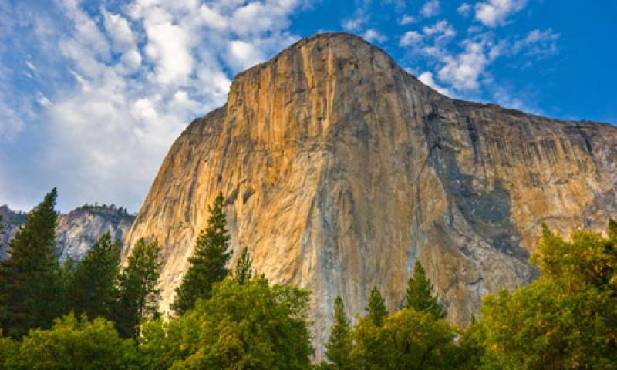
© 2016 Udacity. All rights reserved.
Notes:
Acknowledging anxiety -- and segue into tips for success

Slide 10
Tips for Success
HOW ARE WE GOING TO GET THERE?
Work through the content at a steady pace (10-15 hr /wk + this session)
Time management is a big key
When you are stuck, ask for help
Udacity forums
Your friendly session-lead
Colleagues in your cohort
Google
Keep track of your goal -- try not to get side-tracked on some topic
Keep up with the recommended completion dates for projects
© 2016 Udacity. All rights reserved.

Slide 11
Set up and Verify
LET’S GET STARTED!!
Download Anaconda/Miniconda https://conda.io/docs/user-guide/install/index.html.
Install Anaconda/Miniconda
Download notebooks from Github - https://github.com/zkhundkar/ConnectIntensive
Create environment and install libraries conda env create -f mlnd.yml
Activate your environment [source] activate mlnd
Navigate to the root of the folder where you downloaded the notebooks
jupyter notebook
Open and work through Getting Started.ipynb notebook
© 2016 Udacity. All rights reserved.

Slide 12
Verify your environment
Go through Getting Started notebook from Github

Slide 13
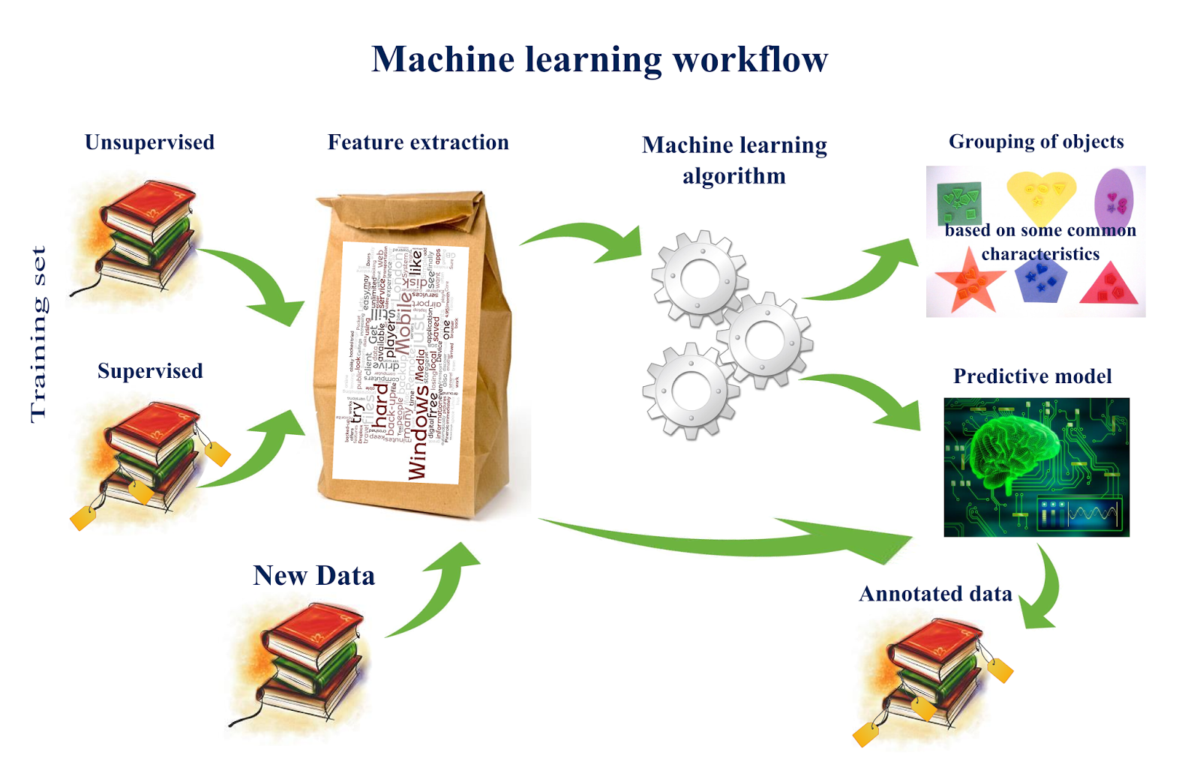
http://www.computervisionblog.com/2015/03/deep-learning-vs-machine-learning-vs.html
© 2016 Udacity. All rights reserved.

Slide 14
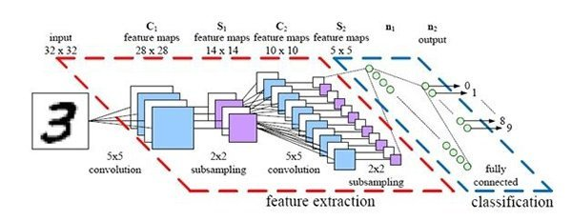
https://analyticks.wordpress.com/2016/08/06/ai-deep-learning-and-machine-learning-a-primer-andreessen-horowitz-tachyeonz/
© 2016 Udacity. All rights reserved.

Slide 15
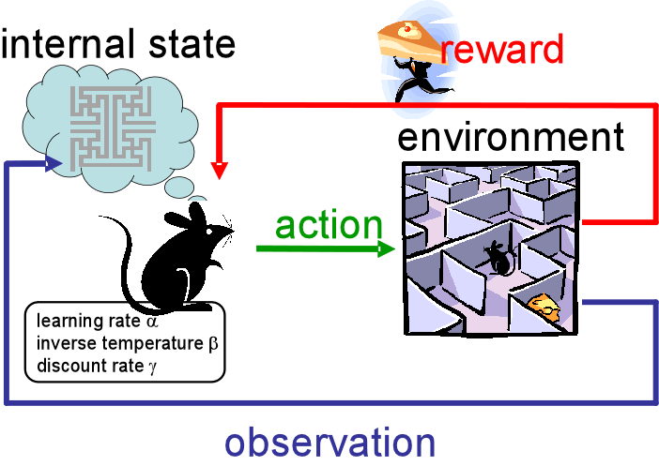
http://www.cs.utexas.edu/~eladlieb/RLRG.html/
© 2016 Udacity. All rights reserved.

Slide 16
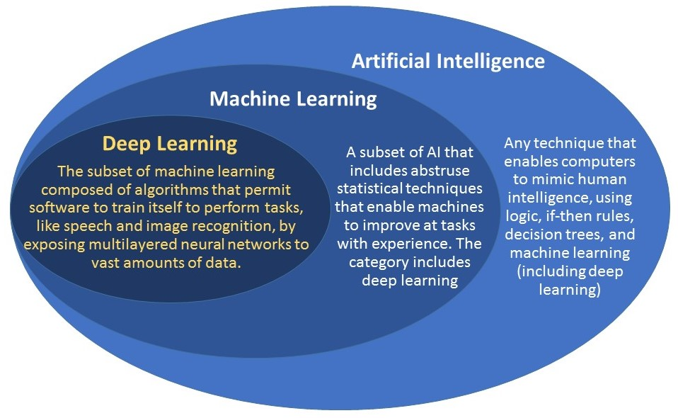
https://www.geospatialworld.net/blogs/difference-between-ai%EF%BB%BF-machine-learning-and-deep-learning/
© 2016 Udacity. All rights reserved.

Slide 17
Lunch Break
Lets meet back here at 1:00 pm

Slide 18
Afternoon Session
1:00 - 1:30 | Using Jupyter Notebook, numpy and pandas
1:30 - 2:00 | Notebook Session - numpy, pandas
2:00 - 2:30 | Session follow up and Intro to Project 0
2:30 - 3:00 | Recap, Lookahead and Feedback
© 2016 Udacity. All rights reserved.
Notes:
No prepared presentation.
Jupyter notebook essentials and tip
Numpy notebook session -- first block student’s on their own, followed by walkthrough solutions with class input
Pandas notebook session -- first block student’s on their own, followed by walkthrough solutions with class input

Slide 19
Data Exploration
Titanic Disaster Survival

Slide 20
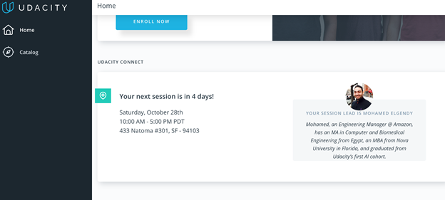
We really need your Feedback!
© 2016 Udacity. All rights reserved.

